Slide 1



Loan Approval Amount Prediction
CAPSTONE FINAL PRESENTATION GROUP - 1

Slide 2

Paycheck Protection Program
The Paycheck Protection Program (PPP) loan is a type of loan established by the US Small Business Administration (SBA) as part of the Coronavirus Aid, Relief, and Economic Security (CARES) Act in response to the COVID-19 pandemic. The purpose of the PPP loan is to help small businesses keep their workers on the payroll during the pandemic. The PPP loans are made through SBA-approved lenders and are fully guaranteed by the federal government.
The aim of the program is to help these businesses keep their employees on the payroll, cover eligible expenses such as rent, mortgage interest, and utilities, and keep their operations running during the crisis.
By providing PPP loans to eligible small businesses, the federal government aims to prevent widespread layoffs, preserve jobs, and support the economy during a time of crisis.
In addition to helping businesses stay afloat, the PPP loan also offers the potential for loan forgiveness if certain conditions are met. This provides an added incentive for small businesses to participate in the program and helps ensure that the funds are being used effectively.

Slide 3
The Business Problem
Problem Statement.
Predict the PPP currently approved loan amount for the Small Businesses.
The objective is to develop a predictive regression model for PPP current approved loan amount.
The model will consider essential borrower’s and lender’s characteristics.
The goal is to help lenders make informed decisions and distribute funds efficiently.
The pandemic's impact on small businesses is a key consideration.

Slide 4


OBJECTIVE
The Paycheck Protection Program (PPP) was established to help small businesses, self-employed workers, nonprofit organizations, and tribal businesses to continue paying their workers. The Paycheck Protection Program allows entities to apply for low-interest private loans to pay for their payroll and certain other costs. Predicting the correct loan approval amount would help the entities in receiving a correct amount of loan so that the business stays afloat.
The Paycheck Protection Program ’s real objective would be fulfilled only if the small businesses facing actual problems would get the efficient amount of funding to keep them afloat. Therefore predicting the correct amount of Loan would help the US Government to help the businesses in the most effective way possible.

Slide 5
UNDERSTANDING THE DATASET
The details regarding loan such as, LoanNumber, Processing date, the approval amounts, loan term, etc. are provided regarding the loan.
1
The borrower details such as the borrower businesses’ name, the borrower geographical details, the number of employees, the project details and whether the business is Non Profit organization. The borrower details and Project details have high similarity. So we would be considering just one amongst them.
2
4
The Lender banks details such as the Lender banks name, the geographical details, the SBA Office code, the servicing banks’ details etc are given. The originating lender banks and servicing banks have almost similar values.
3
The data has high amount of Missing Values, Skewness i.e., the data is not normally distributed, the data has high multicollinearity which might impact the models and predictions later on.

Slide 6
DATA PREPROCESSING
Cleaning the data:
Changing the data types of date columns from object to DateTime.
Changing the data types of numeric columns from object to numeric datatype.
Changing the data to lowercase in categorical columns like City and State to avoid discrepancy in the data.
Filling the Missing values in the data:
The proceeds columns had high number of missing values. But according to the domain knowledge and the information on PPP loans, it was filled with zeroes.
95.23%
MORTGAGE_INTEREST_PROCEED
97.61%
REFINANCE_EIDL_PROCEED
96.28%
Franchise Name
3.03%
Forgiveness Amount

Slide 7
DATA PREPROCESSING
Filling the missing values:
We converted the Franchise column as to whether the businesses is a franchise or not.
The remaining columns were filled using mode for the categorical columns and median for the numerical columns if any.
Dropping the unnecessary columns:
The loan Number column had all distinct values, and SBA Guaranty Percentage had all the same values, therefore they were dropped.
The Project details columns and Servicing lender details columns were dropped as they had approximately above 95% similar values.
Outliers Treatment:
Even after applying different transformations, the data was highly skewed, therefore the data was split in two parts of one having outliers only data and another one of without outliers using the limit of Q3+1.5*IQR.
There were still some outliers left, therefore the power transformer was applied in the data.
Scaling: As the data had quite different scales in different predictors, when we used power transformer, it transformed as well as scaled the data.
Encoding:
Frequency Encoding: For some predictors like city and location Ids and state and business type, frequency encoding using nunique transformation was applied. Some were encoded using factorize function of the pandas library.
One Hot Encoding: For some predictors like race, gender, ethnicity, business age description OHE was applied.

Slide 8
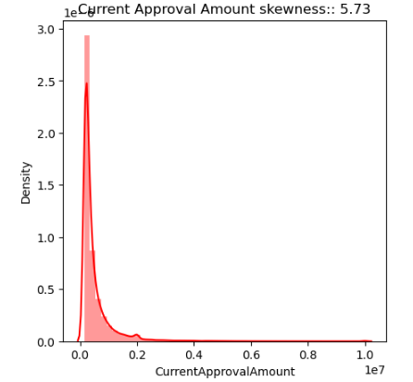
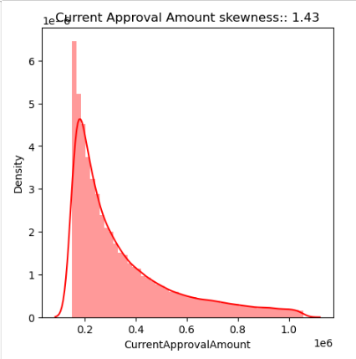
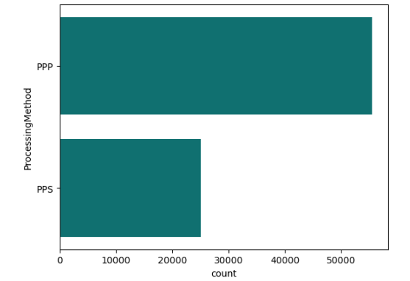
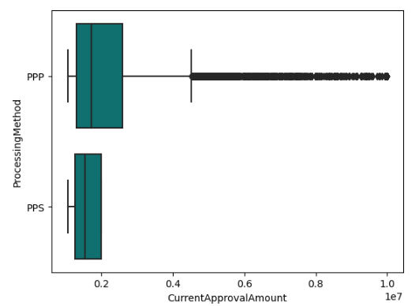
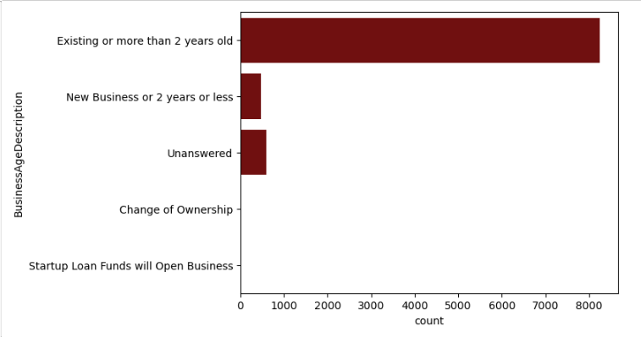
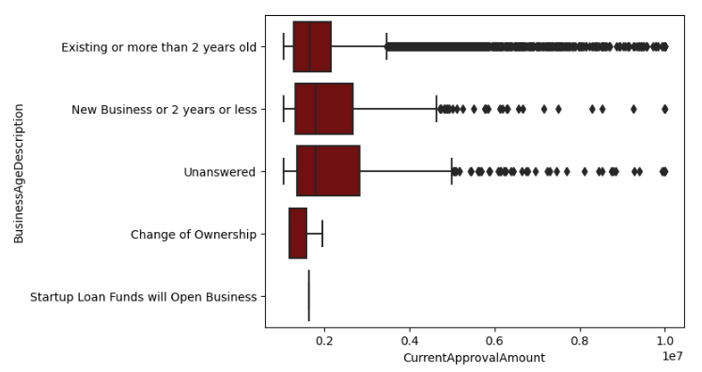
EXPLORATORY DATA ANALYSIS
The Target Variable: Current Approval Amount
It was highly skewed therefore it was divided into two parts, of outliers and without outliers data.
The loans were processed using two methods PPP and PPS. Some of the business owners had taken loan twice, therefore the processing method used was PPS.
The maximum number of loans were provided to businesses which were 2 years or more older. The businesses experiencing change of ownership and Startups got the least number and amount of loans.

Slide 9
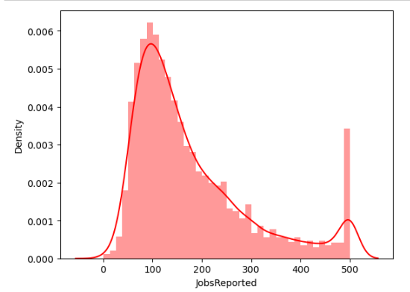
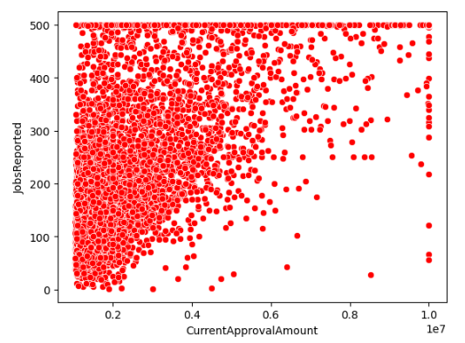
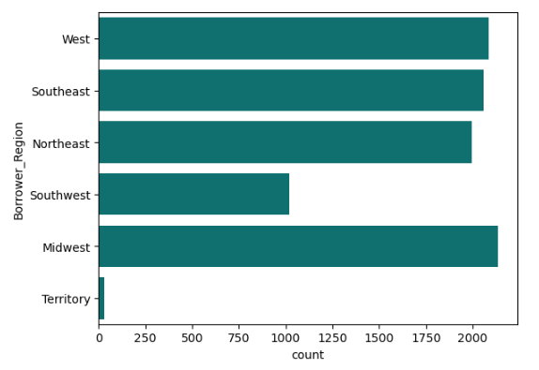
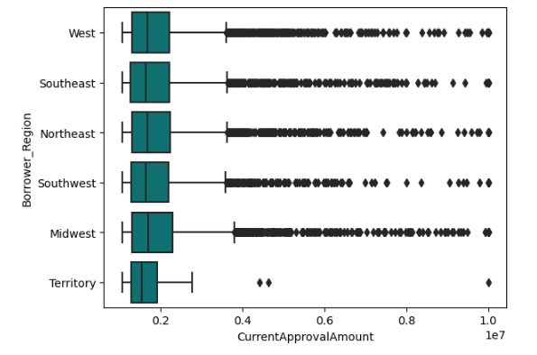
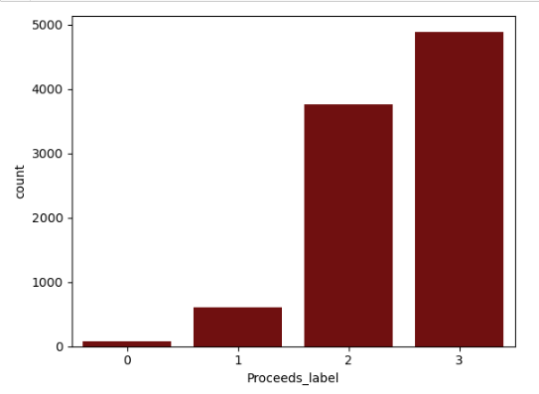
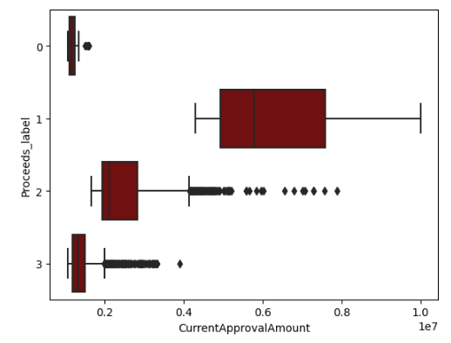
EXPLORATORY DATA ANALYSIS
The loan amount was dependent on the number of employees working. Maximum entities has employees in range of 50 to 150. The loan amount increases with increase in number of employees
The states were binned as per their respective regions. The region like the territories have the least amount of borrowers indicating less number of business establishments in such regions.
The maximum loans come under cluster 2 and 3, but the highest loan amount come under cluster 1, whereas the loans under cluster 1 were of the least amount.

Slide 10
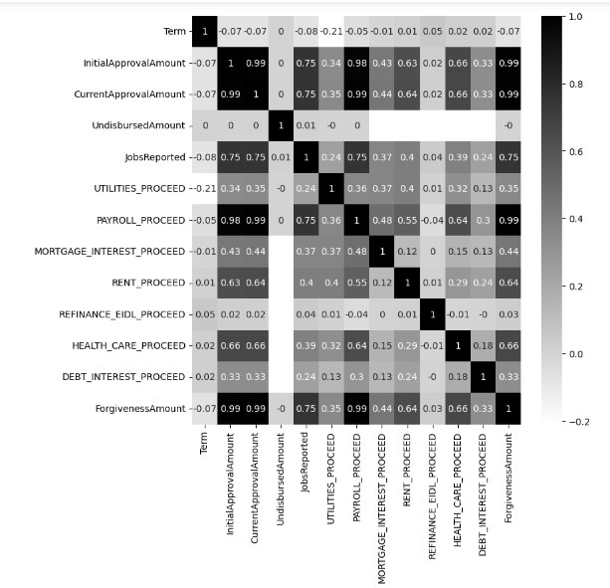
EXPLORATORY DATA ANALYSIS
Most of the Predictors are highly correlated to each other, but also highly related to the Target variable. The Forgiveness amount, Payroll proceeds columns might directly explain the Target variable. The data has high multicollinearity as well.

Slide 11
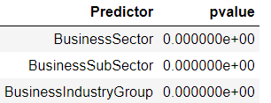
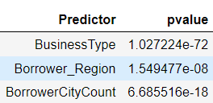
FEATURE ENGINEERING
Binning of Categorical columns:
The States were binned into Regions according to US Information.
The cities were binned based on the number of loans borrowed in that city.
The business Types were binned into three categories of Corporations, Non-Profit Organizations and others.
Deriving New Features:
There were 3 new features Business Sector, Business Sub Sector and Business Industry group were derived from the NAICS Code of the businesses.
The Date, Month, Year were extracted from the Loan Approval Date and Loan Status Date, difference between these was also derived.

Slide 12

FEATURE ENGINEERING
The Franchise Name had a large amount of missing values, therefore it was converted as whether it is a Franchise? (Yes or No).
From Borrower Name, We created a new column of Repeat Borrower (Yes or No) based on the number of loans the borrower had taken.
Clustering:
Proceeds Labels: The proceeds columns were used in a clustering model and there came out to be 4 different clusters. So it was created as a new feature Proceeds Labels.

Slide 13
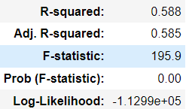
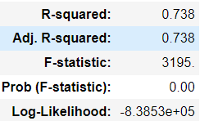
BASE MODELS
OLS Model for Without Outliers Data::
The R-squared is 0.738, The test RMSE is: $106848.4986. The pvalue is below 0.05, therefore the model is a significant one. Some columns were dropped based on pvalue in the Base model .
OLS Model for Outliers Data::
The R-squared is 0.588, The test RMSE is: $903141.9237. The pvalue is below 0.05, therefore the model is a significant one. Some columns were dropped based on pvalue in the Base model and VIF.

Slide 14
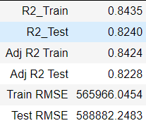
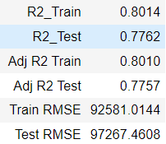
FINAL MODELS
LGBM Regressor Model for Without Outliers Data::
After applying all the models the LGBM Regressor was giving the best R-sq and least RMSE value. Therefore we tuned the LGBM Regressor model and applied Sequential Feature Selector to get a better result.
Gradient Boosting Regressor Model for Outliers Data::
After all other regression models were applied, the gradient Boosting Regressor model gave the best R-sq and least RMSE value, therefore it was tuned to get a better result.

Slide 15

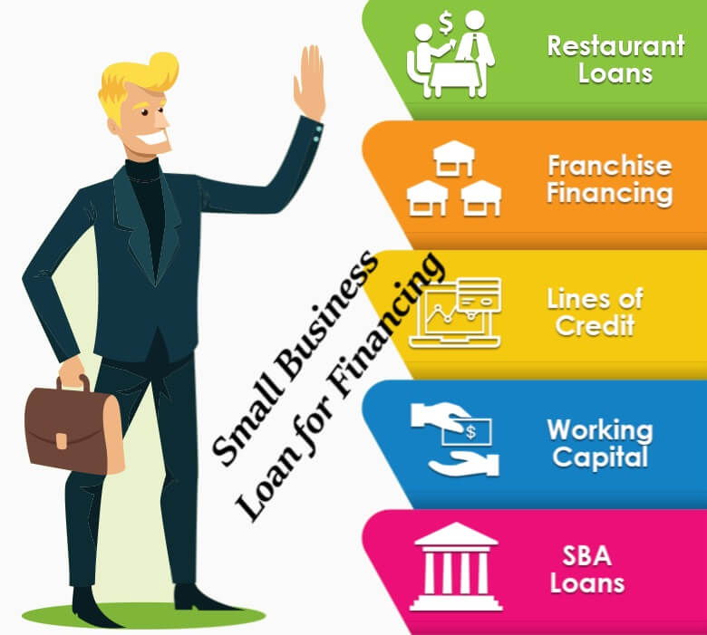

REFERENCES
The Dataset was picked from Kaggle: SBA_PPP_Kaggle
Some Other sources:
sba_official_website
PPP_official_website
wikipedia_PPP
JPMorgan_research_papers

Slide 16
THANK YOU

